Slide 1
ICS 141 – Programming With Objects
Lecture 5 – Robert Jahn

Slide 2
Schedule
Tracing through an example(Dog) 6:45 – 7:00
getters/setters/toString 7:00 – 7:10
Static Vs Instance 7:10 – 7:20
Exercise 5(a) + Break 7:20 – 7:30
Thinking in Objects 7:30 – 7:50
Exercise 5(b) 7:50 – 8:00
UML Class Diagrams 8:00 – 8:10
String Class 8:10 – 8:20
Assignment #5 8:20 – 8:30

Slide 3
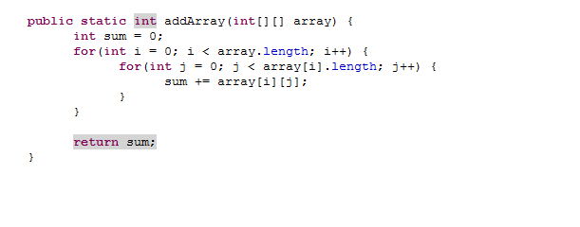
Exercise Review

Slide 4
Tracing Through an Example
Dog class.

Slide 5
Getters/Setters
Getters and setters are special methods that we will tend to define in our class definitions.
They are directly tied to the data fields of the class.
Getters return the value currently being stored in a particular data field.
Setters take a single parameter as input and sets the particular data field to this passed value.

Slide 6
toString()
The toString method is another special type of method that we’ll often define in our classes.
The idea behind the method is to return an object of the class in “String form”.
What does this mean?
We generally grab any of the important data fields and output them in the form of a String.

Slide 7
Static Vs Instance

Slide 8
Instance Variables, and Methods
Instance variables belong to a specific instance, or object, of a class. Instance methods are invoked by an instance of the class.

Slide 9
Static Variables, Constants, and Methods
Static variables are shared by all the instances of the class. Static methods are not tied to a specific object.
Static constants are final variables shared by all the instances of the class.

Slide 10
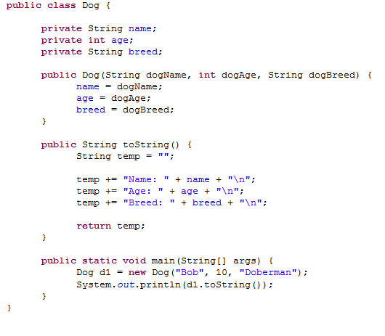
Calling instance methods
First, let us refresh ourselves on how to call instance methods.
Focusing on the main method, we can see we’ll create a Dog object. In the next line, we take that Dog object reference, d1, and call toString directly on this reference.
This is how we call instance methods. We call them on our actual objects using the dot-operator.

Slide 11
Static methods
But, how do we call a static method?
We’ll only ever create static methods in situations where we want the method to be shared by the entire class.
Given this, we cannot alter/access instance data fields within our static method definitions.
So, since we do not use static methods to alter our objects, how are we going to call them?

Slide 12
Static methods
We’ll use the name of the class, rather than the name of an actual object.
We have been doing this all along, actually.
For instance, consider the following example from a couple weeks ago.

Slide 13
Static methods
double[] values = new double[10];
for(int i = 0; i < values.length; i++) {
values[i] = Math.random() * 100;
}
/* This for-loop will fill the array with double values ranging from [0.0,100.0). */
The call here to Math.random() is a call to a static method.
random() is a static method defined in the Math class.
Note the syntax here.

Slide 14
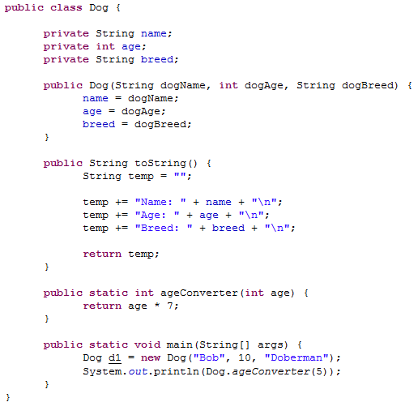
Static methods
Note the difference here. Instead of prefixing ageConverter with our Dog object, d1, we use the name of the class itself.
Note that we could actually call age converter using our reference d1. However, the compiler would give us a warning that the method should only be accessed in a static way.
Note that we do not even have to create a Dog object before we use this static method. It can be used before the creation of any actual objects.

Slide 15
Passing objects to methods
We’ve seen that we can define classes and create objects based on those class definitions.
We have also used these objects in forming our solutions.
One aspect of this that we have not yet discussed is the notion of passing objects to our methods as input parameters.
How do we go about doing this?

Slide 16
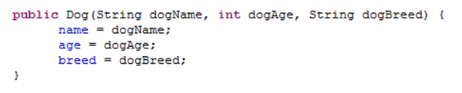
Passing Objects
As we’ll see, it is quite simple.
We’ve actually been doing this all along within our user-defined constructors whenever we had passed a String to our constructors.

Slide 17
Passing Objects
We can do the same with our user defined objects.
Assume the same Dog class.
Let us write out a method that takes a single Dog object as input and prints out the String form of our Dog object.

Slide 18
Passing Objects
What will be the return type?
void
What will the signature be?
printDog(Dog d1)
How about the method contents?
{
System.out.println(d1.toString());
}

Slide 19
Exercise #5a

Slide 20
Thinking in Objects (10) - Motivations
In ICS 140 you modeled solutions from a procedural point-of-view. The problems were fairly simple and we were able to model rather simple solutions. Today, we’ll continue our change of mindset to the OOP paradigm.
A few topics include variable scope within a class, the this keyword, abstraction, and composition.

Slide 21
OOP vs Procedural
OOP can be generally characterized as a paradigm that requires greater overhead, but in the long run, allows us to work with giant projects more effectively.
That is, the larger our programs become, the greater the advantage is for using OOP over procedural.
This is because the OOP paradigm allows us to break the problem down into modules. We can then focus on these individual modules at any given time, without having to worry about what comes ‘before’ or ‘after’.
The key here is that all of these modules/classes must be built to exact specifications, so that they all work together flawlessly.
One small error can therefore break the entire program. However, you will have a good idea in which module the error has occurred.

Slide 22
Variable Scope
The scope of instance and static variables is the entire class. They can be declared anywhere inside a class.
We generally declare these right at the top of a class definition for consistency purposes.
Note that instance variables will be given default values if not explicitly set.
The scope of a local variable starts from its declaration and continues to the end of the block that contains the variable. A local variable must be initialized explicitly before it can be used.
The local variable will take precedence over an instance/static variable within the same scope if they have identical names.

Slide 23
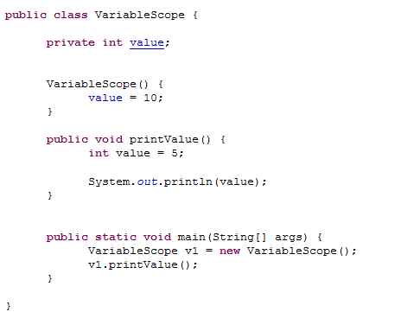
Variable Scope
What will be printed? Remember that local variables take precedence in the block they are declared.

Slide 24
The this Keyword
The this keyword is the name of a reference that refers to an object itself. One common use of the this keyword is to reference a class’s hidden data fields.
Note the specifics here:
The this keyword is a reference, meaning it points to the actual object.
Normally, we omit the use of this; however, it becomes necessary when we want to distinguish between local variables and instance variables of the same name.

Slide 25
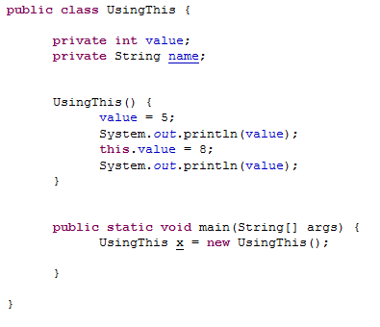

The this Keyword

Slide 26
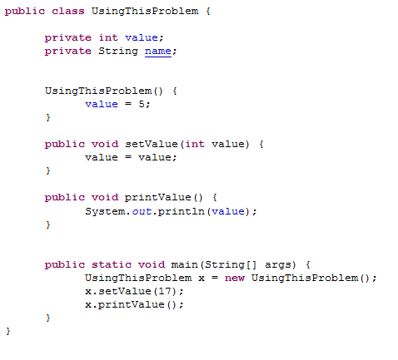
The this Keyword
This will result in an error. Do you know what type of error is present in this code?
Syntax
Runtime
Logic

Slide 27
The this Keyword
This version of the code will work correctly. The value 17 will now be printed.
Note that the only difference is within the setValue method. Now we are using the this keyword to appropriately distinguish between the local parameter and the data field.

Slide 28
Class Abstraction and Encapsulation
Class abstraction means to separate class implementation from the use of the class. The creator of the class provides a description of the class (Class contract) and lets the user know how the class can be used. The user of the class does not need to know how the class is implemented. The detail of implementation is encapsulated and hidden from the user.
It is better to hide the actual implementation and instead specify the class contract. This forces the class to work as a black-box. This means we’ll know how the class behaves, but not specifically how it attains this behavior.

Slide 29
Examples
display
s1 == s2 is false
s1 == s3 is true
A new object is created if you use the new operator.
If you use the string initializer, no new object is created if the interned object is already created.

Slide 30
Unified Modelling Language
Developed in the 1990s.
Used in the field of software engineering to graphically model systems which utilize the object-oriented design philosophy.
Many different types of diagrams.
We’ll focus on class diagrams.

Slide 31
Visibility Modifiers
We have discussed two of the visibility modifiers to this point.
public
private
We’ll also consider two more for this lecture.
protected
default
In our class diagrams, it would be cumbersome to write out these phrases each time. Therefore, we use the following symbols to represent these visibility modifiers.
public +
private -
protected #
default ~

Slide 32
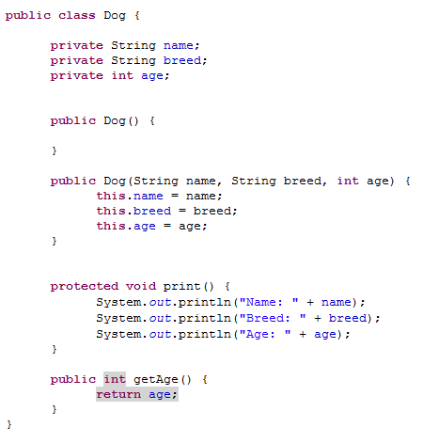
Class Diagrams
Consider this class. Over the next few slides we shall fill out the corresponding class diagram for this Dog class.

Slide 33
Class Diagrams
The first step is to create a 3-section box. The name of the class is placed in the first section.

Slide 34
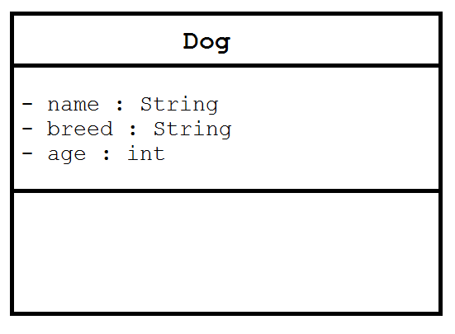
Class Diagrams
Next, we place the data fields into the second section. Notice the syntax here.
visibility variableName : variableType

Slide 35
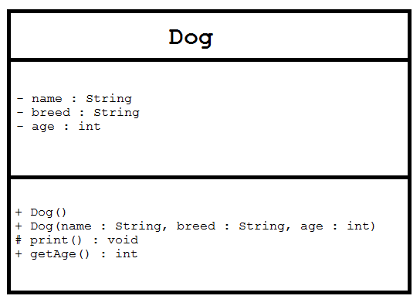
Class Diagrams
Next, we place the constructors/methods into the third section. Notice the syntax here for constructors and methods respectively.
visibility className(parameters)
visibility methodName(parameters) : returnType

Slide 36
Class Diagrams
Other things to note.
We represent a static field/method by underlining field/method.
In these slides we looked at individual class diagrams. When we start building multiple-class solutions, we shall draw overall class diagrams that show how the different classes interact with each other.

Slide 37
Motivations
Often you encounter the problems that involve string processing and file input and output. Suppose you need to write a program to replace all occurrences of a word with a new word in a file. How do you solve this problem? This chapter introduces strings and text files, which will enable you to solve this problem.
We’ll focus on the String class for now, and we’ll consider text files in more detail later on when we get to file I/O.

Slide 38
The String Class
The String class is the first one we’ll take a good close look at. Now that we have a somewhat good understanding of classes, we’ll look at this very important Java class.
Although we’ve worked with classes quite a bit, we haven’t really delved into an actual Java class definition in the detail we’ll see tonight. This will help to foster your understanding of classes.

Slide 39
Constructing Strings
String newString = new String(stringLiteral);
String message = new String("Welcome to Java");
Since strings are used frequently, Java provides a shorthand initializer for creating a string:
String message = "Welcome to Java";

Slide 40
Strings Are Immutable
A String object is immutable; its contents cannot be changed. Does the following code change the contents of the string?
String s = "Java";
s = "HTML";

Slide 41
Trace Code
animation
String s = "Java";
s = "HTML";

Slide 42
Trace Code
animation
String s = "Java";
s = "HTML";

Slide 43
Interned Strings
Since strings are immutable and are frequently used, to improve efficiency and save memory, the JVM uses a unique instance for string literals with the same character sequence. Such an instance is called interned. For example, the following statements:

Slide 44
Examples
display
s1 == s2 is false
s1 == s3 is true
A new object is created if you use the new operator.
If you use the string initializer, no new object is created if the interned object is already created.

Slide 45
Trace Code
animation

Slide 46
Trace Code

Slide 47
Trace Code

Slide 48
Exercise #5b

